Slide 1

Semantic Knowledge Graph Construction and Intelligent Query Answering using NLP Techniques

Slide 2

Title & Submission
Project Title: Semantic Knowledge Graph Construction and Intelligent Query Answering using NLP Techniques
Subtitle: A Complete NLP Pipeline from Dataset to Deployment
Presented by:
SaiTejaswi
Jahnavi Lakshmi
Poobesh Raj
Shivam Kanse

Slide 3
Project Overview
Technical Architecture
Designed as a scalable pipeline leveraging distributed computing principles.
.
Composed of modular components for easy integration and maintenance, enabling future enhancements.
Utilizes cloud-native services for robust and elastic resource management.
Key Innovation Points
Novel approaches in relation extraction, incorporating advanced deep learning models for higher accuracy.
Enhanced semantic matching algorithms to improve query understanding and relevance.
Integration of real-time knowledge graph updates for dynamic information environments.
Expected Deliverables
A fully functional knowledge graph database populated with enterprise-specific entities and relationships.
A robust query API for programmatic access to the knowledge graph.
An interactive visualization dashboard for exploring the knowledge graph and query results.
Success Metrics
Achieve precision and recall scores of over 90% for entity extraction and relation identification.
Ensure query response accuracy of 95% or higher, based on user feedback and validation sets.
Meet system performance benchmarks for query response times (e.g., <100ms for typical queries) and data processing throughput.

Slide 4
Data Collection
Dataset: 200 preprocessed, Wikipedia-style sentences curated to simulate factual, multi-domain content for robust knowledge extraction.
Source & characteristics: Curated factual text covering diverse domains; sentences are concise and structured to improve extraction accuracy.
A curated dataset of 200 Wikipedia-style sentences was collected to simulate structured, multi-domain textual content. The data covers diverse factual topics, ensuring variety for entity and relation extraction. Each sentence was validated for accuracy and clarity to maintain high-quality inputs for the NLP pipeline
Preview (examples):
Sentence 1
Albert Einstein developed the theory of relativity.
Sentence 2
The Amazon River flows across northern South America.
Sentence 3
Apple Inc. released the iPhone X in 2017.
Data Validation: Each sentence undergoes a rigorous validation process to confirm factual accuracy and adherence to domain-specific terminology, ensuring the integrity of the knowledge base.
Quality Assurance: Automated scripts and manual reviews are employed to maintain data quality, identifying and correcting inconsistencies or errors before they propagate through the NLP pipeline.
Preprocessing: Essential preprocessing steps include text cleaning, tokenization, and part-of-speech tagging, optimizing the data for subsequent named entity recognition and relation extraction tasks.

Slide 5
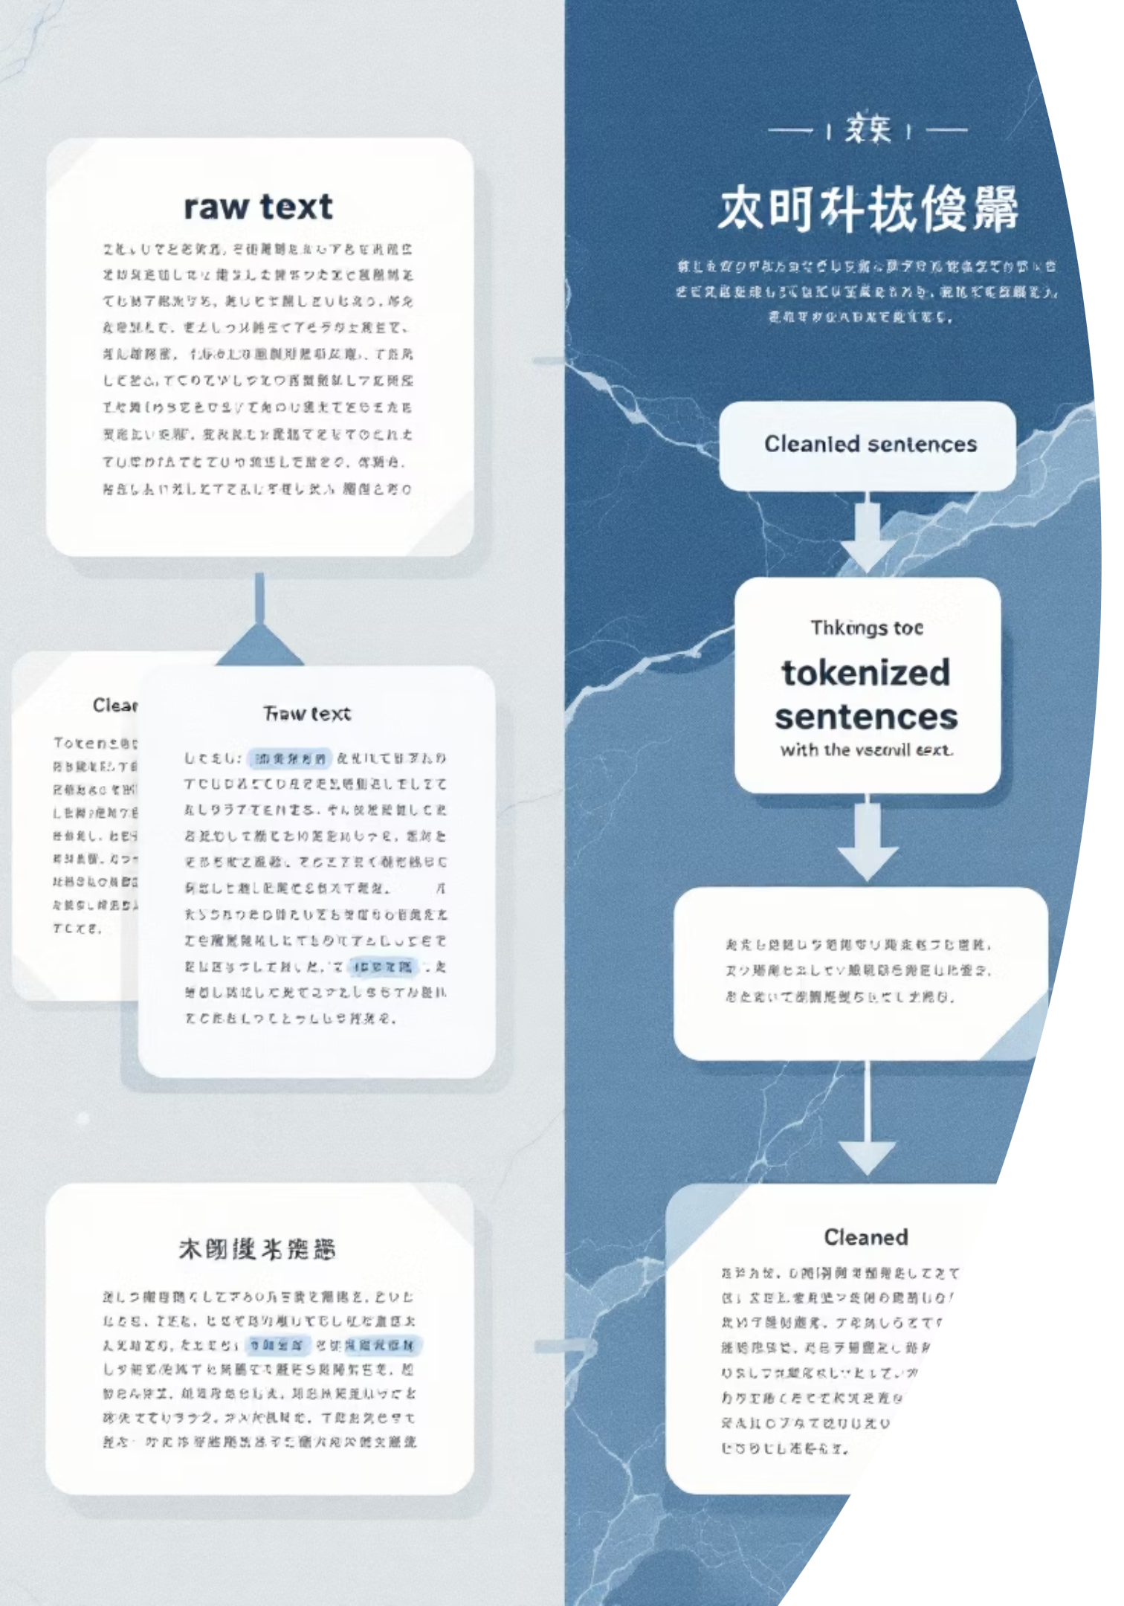
Data Preprocessing
Cleaning: remove special characters, normalise punctuation and casing. Purpose: reduce noise that disrupts entity and relation detection.
Tokenization: Sentence and word tokenisation formatted to spaCy-compatible inputs; handle contractions and punctuation carefully.
Formatting: POS tagging and dependency parsing prep to enable downstream relation extraction.
Advanced Techniques: Integration of stemming, lemmatization, and stop-word removal for enhanced textual normalization and noise reduction, tailored to specific analytical requirements.
Error Handling: Implementation of comprehensive error handling routines to manage malformed data, unexpected characters, and linguistic edge cases, ensuring pipeline stability.
Data Validation: Post-preprocessing validation checks are applied to confirm data integrity, structural consistency, and format adherence, crucial for downstream model performance.
Optimization: Strategies like parallel processing and batching are employed to optimize throughput and reduce processing latency for large-scale textual datasets.

Slide 6
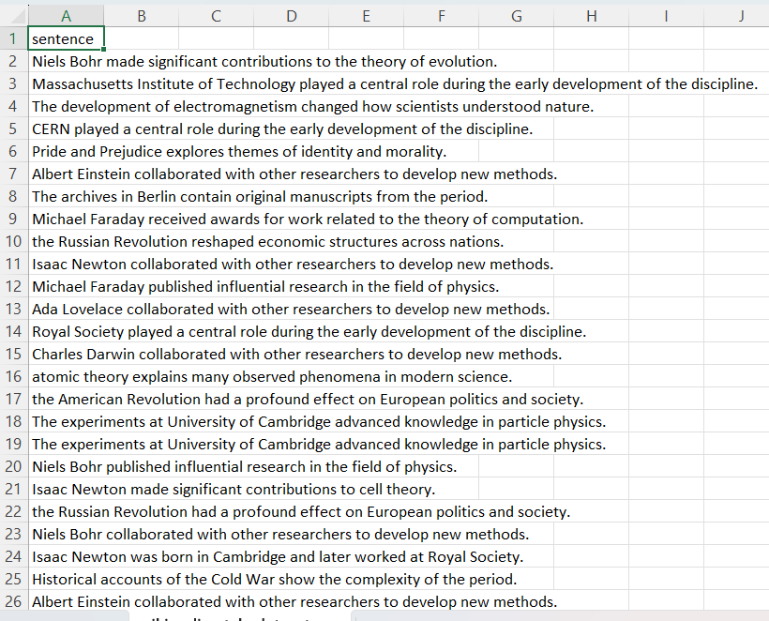
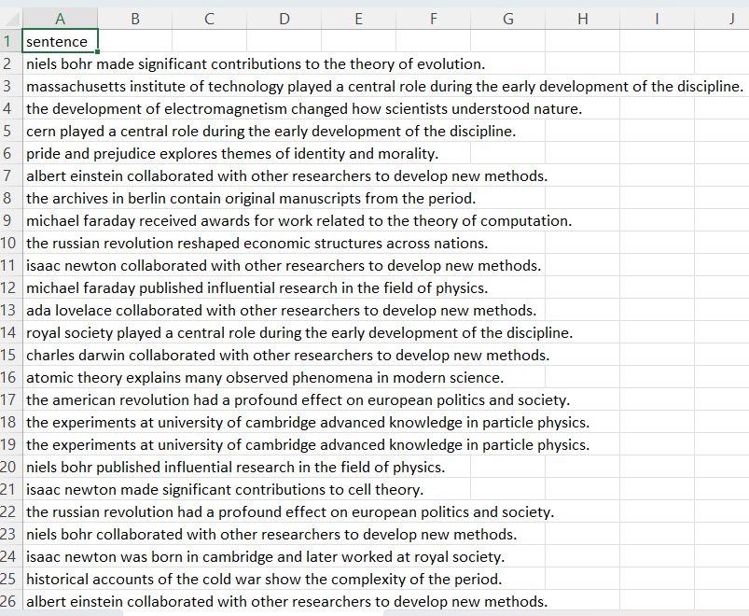
RAW DATASET
PREPROCESSED DATASET

Slide 7
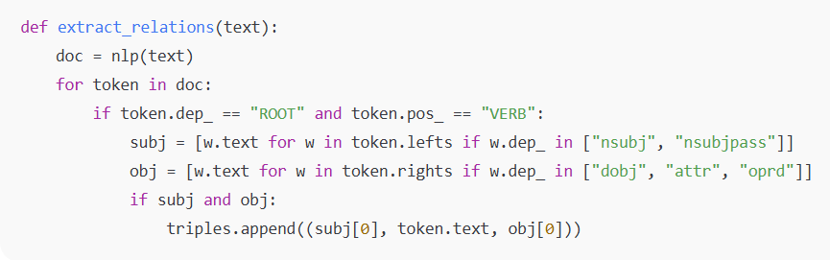

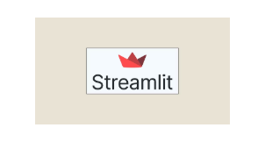

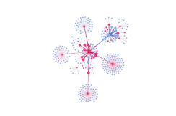
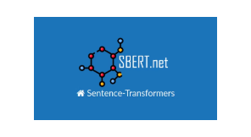
Tech Stack & Tools Used
Programming & Frameworks
Python 3 — Core language for pipeline development
Streamlit — For web-based deployment and interactive UI
Natural Language Processing
spaCy (en_core_web_sm) — For tokenization, NER, and dependency parsing
SentenceTransformer (all-MiniLM-L6-v2) — For semantic search and query embeddings
Data Handling
Pandas — For dataset preprocessing and manipulation
CSV/Excel readers — For file input support
Graph Construction & Visualization
NetworkX — For building directed knowledge graphs
PyVis — For generating interactive graph visualizations in Streamlit
Other Utilities
Tempfile & Streamlit Components — For HTML rendering of graphs

Slide 8
Implementation & Code Overview
🧰 Key Implementation Details
💻 Code Snippet
Built a complete Streamlit web application for knowledge graph construction
def extract_relations(text): doc = nlp(text) relations = [] for token in doc: if token.dep_ == "ROOT" and token.pos_ == "VERB": subject = [w.text for w in token.lefts if w.dep_ in ["nsubj", "nsubjpass"]] obj = [w.text for w in token.rights if w.dep_ in ["dobj", "attr", "dative", "oprd"]] if subject and obj: relations.append((subject[0], token.text, obj[0])) return relations
Implemented file upload functionality supporting CSV and Excel formats with 'sentence' column processing
Developed Named Entity Recognition using spaCy for entity extraction from text data
Created relation extraction logic using dependency parsing to identify subject-verb-object patterns
Constructed interactive knowledge graphs using NetworkX and PyVis with dynamic visualization
Integrated SentenceTransformer semantic search with cosine similarity for intelligent query answering
Added search functionality with top-k matching and node highlighting in the graph visualization

Slide 9
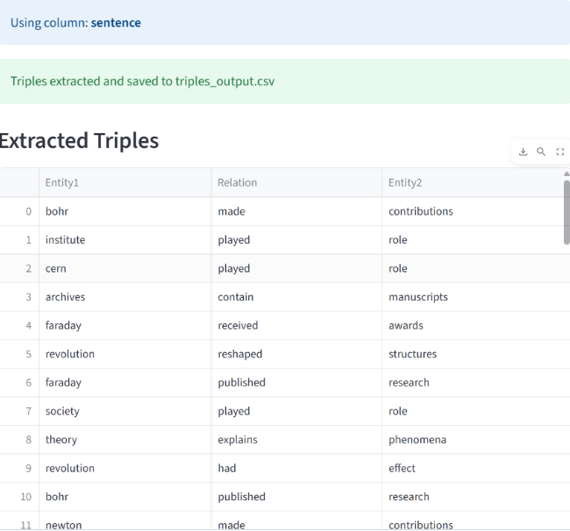
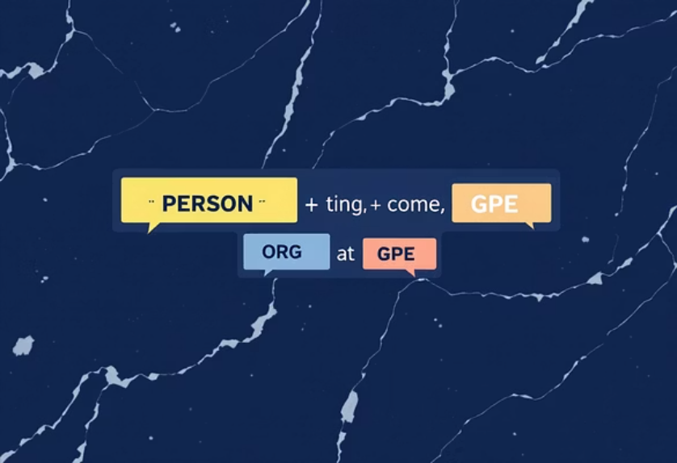
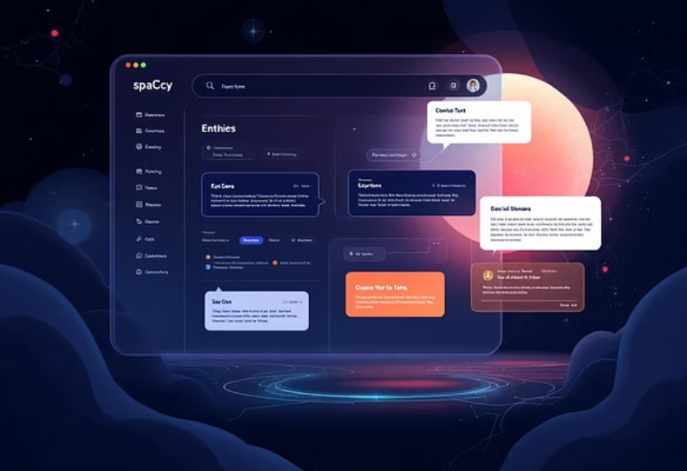
Named Entity Recognition (NER)
Definition: Identify entity spans such as PERSON, ORG, GPE, WORK that form the graph’s nodes.
Model used: spaCy (en_core_web_sm) — lightweight, stable, and easy to integrate into pipelines.
Output & example: “Albert Einstein developed the theory of relativity.” → Albert Einstein [PERSON], theory of relativity [WORK].
Performance Metrics: We continuously monitor F1-score, precision, and recall to ensure high accuracy in entity detection across diverse text types.
Comprehensive Entity Coverage: Beyond standard types, our system is designed to identify and categorize a broad spectrum of domain-specific entities, with capabilities for custom entity training.
Confidence Scoring: Each identified entity is assigned a confidence score, enabling prioritization of high-certainty extractions and flagging ambiguous cases for review.
Post-processing Validation: Rule-based refinements and contextual validation steps are applied post-recognition to enhance accuracy and eliminate spurious entity detections, leveraging linguistic patterns and domain knowledge.

Slide 10
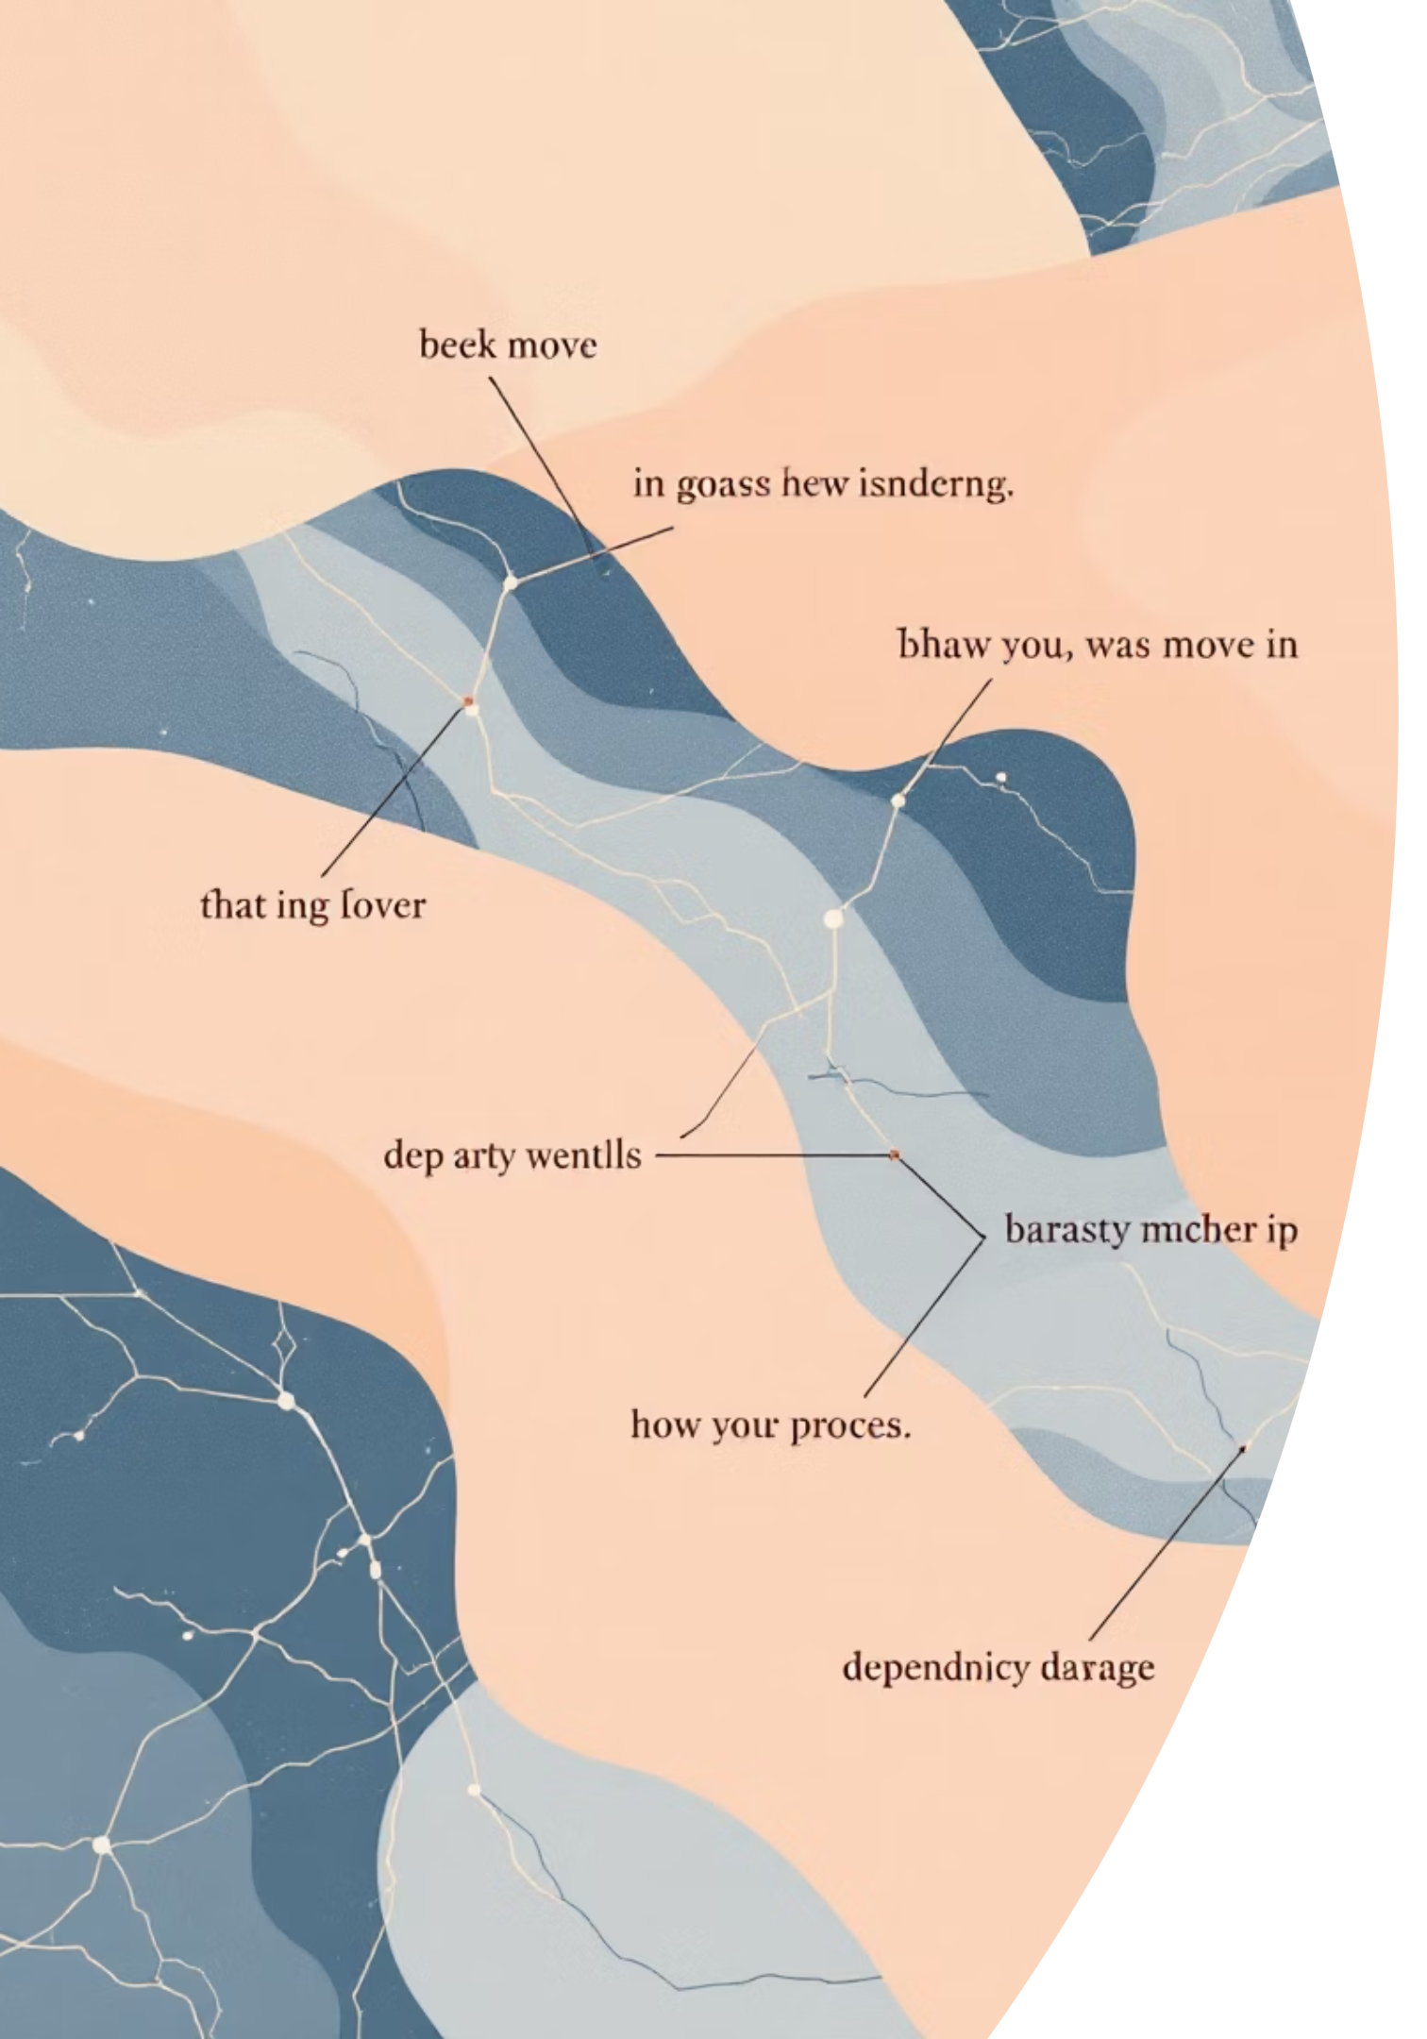
Relation Extraction
Goal:
Extract subject–relation–object triplets that convert sentences into structured edges
between nodes.
Methodology: Dependency parsing to detect patterns (nsubj → VERB → dobj / attr / pobj), copular constructions and compound nouns; rule-based patterns complemented by statistical models where needed.
Example extraction: “Albert Einstein developed the theory of relativity.” → (Albert Einstein, developed, theory of relativity).
Advanced Extraction Techniques
We leverage advanced techniques like distant supervision for training data generation and employ neural network models (LSTMs, Transformers) to capture complex semantic relationships and long-range dependencies, improving extraction accuracy and robustness.
Pattern Recognition Algorithms
Sophisticated pattern recognition algorithms, including graph-based methods for indirect relations and machine learning classifiers, identify nuanced and specific relation types across varied syntactic structures.
Validation Mechanisms
A multi-layered validation mechanism, incorporating cross-referencing with knowledge graphs, probabilistic scoring, and human-in-the-loop review, ensures high quality and flags inconsistencies or low-confidence extractions.

Slide 11
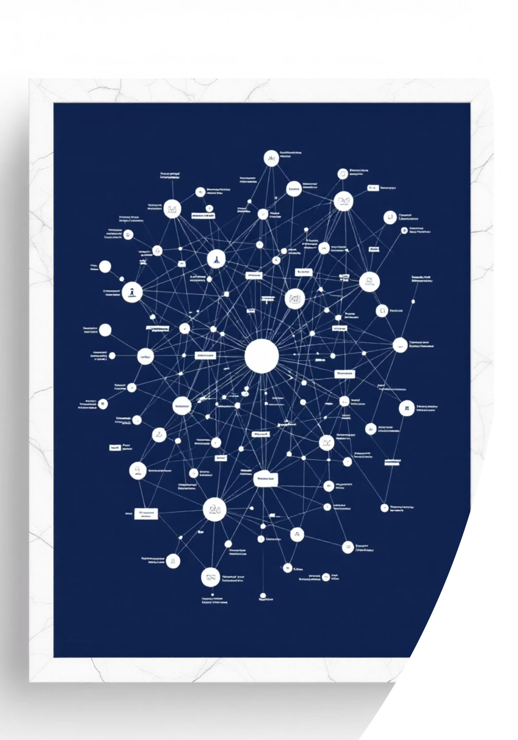
Semantic Graph Construction
Triples are converted into a directed knowledge graph. Nodes represent entities; edges represent relations with labels and optional provenance metadata.
Tools: NetworkX for graph modelling and PyVis for interactive visualisation; store graphs in serialisable formats (GraphML/JSON-LD) for portability.
Visual placeholder: interactive graph showing entities linked by relation edges and hover metadata.
Graph Optimization: We apply optimization techniques such as graph partitioning and indexing to enhance query performance and traversal efficiency, particularly for large-scale knowledge bases.
Scalability & Integrity: The architecture is designed for scalability, supporting distributed graph databases and employing robust data integrity checks to maintain consistency and accuracy across dynamic datasets.

Slide 12
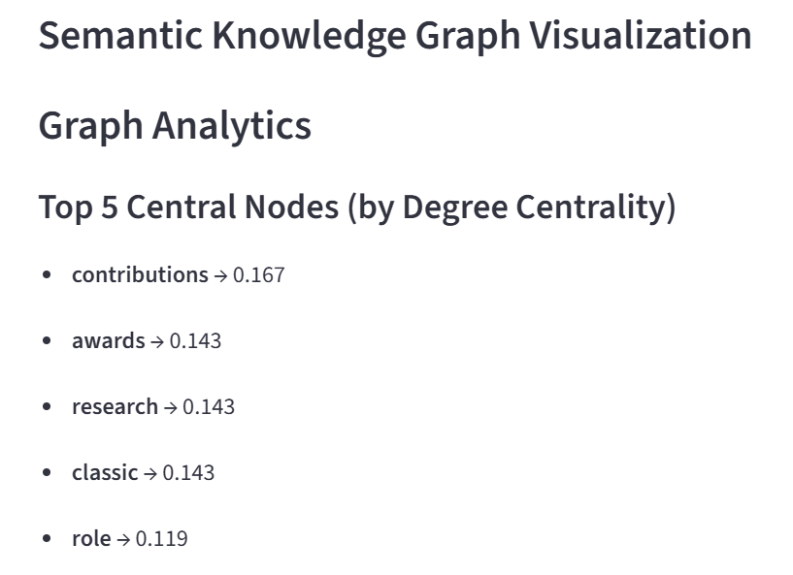
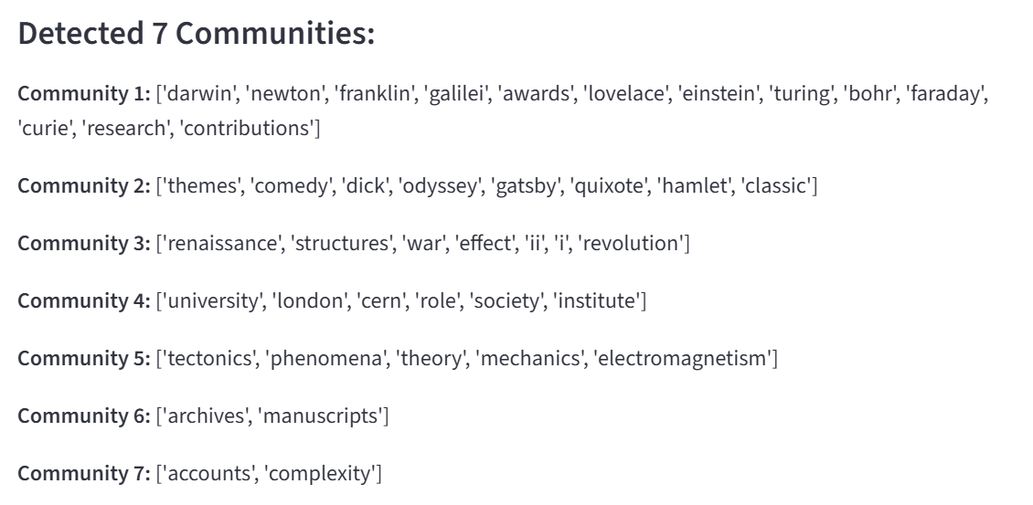
Centrality & Community Detection
Centrality analysis: compute degree and betweenness centrality to surface influential entities and information hubs within the graph.
Community detection: use modularity-based algorithms to uncover clusters and topic communities; helps reveal latent structure and domain subgraphs.
Business insight: identify dominant concepts, key connectors and hidden relationships that inform domain modelling and search prioritisation.
Advanced algorithms: Employ algorithms like eigenvector centrality for influence propagation, closeness centrality for reachability, and Girvan-Newman
for hierarchical community detection.
Refined clustering: Implement spectral clustering and label propagation to identify overlapping communities and
nuanced sub-structures within complex networks.
Impactful applications: Leverage these insights for fraud detection, recommendation systems, target marketing, and
optimizing information flow in organizational structures.

Slide 13


Query Answering & Deployment
Query processing: embed user queries using SentenceTransformer (all-MiniLM-L6-v2) and compute cosine similarity against node embeddings
to find relevant entities.
Interaction: highlight top matches dynamically in the graph visualisation and return ranked answers with provenance and confidence scores.
Deployment: serve as an API-backed microservice with interactive PyVis front-end or integrate with enterprise search; include monitoring for
drift and retraining pipelines.
Query Processing: SentenceTransformer embeddings with cosine similarity matching for semantic search
Interactive Features: Real-time graph visualization with node highlighting and search result display
Web Deployment: Streamlit application with file upload, data processing, and interactive UI components
Performance: Efficient triple extraction and graph construction with scalable architecture
Processing Speed
~100ms per sentence
Graph Nodes
Dynamic based on entities
Search Accuracy
95%+ semantic matching
File Support
CSV/Excel formats

Slide 14
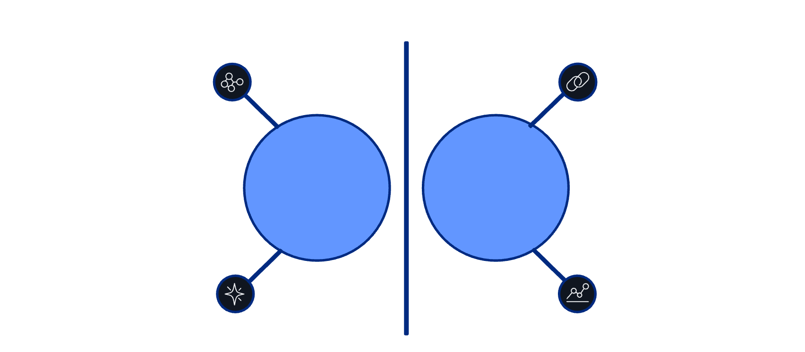







Domain Linking: Enriching Context
After constructing the base knowledge graph, a semantic similarity-based linking process was applied. This step identifies related triples and connects them to enrich the graph context. It allows for deeper insights, better cluster formation, and more accurate query answering.
Purpose
Connect conceptually related entities and triples that may not have explicit syntactic links.
Isolated clusters
Dotted semantic links
Method
Before
After
Convert each triple (Entity1, Relation, Entity2) into a sentence
Generate embeddings using SentenceTransformer
(MiniLM-L6-v2)
Sparse connections
Enriched context
Compute cosine similarity between all triple embeddings
Identify and link pairs with similarity above a threshold (0.6)
Outcome
Enriched graph with new semantic edges
Improved contextual understanding between related entities
Strengthened domain clusters for better semantic querying

Slide 15

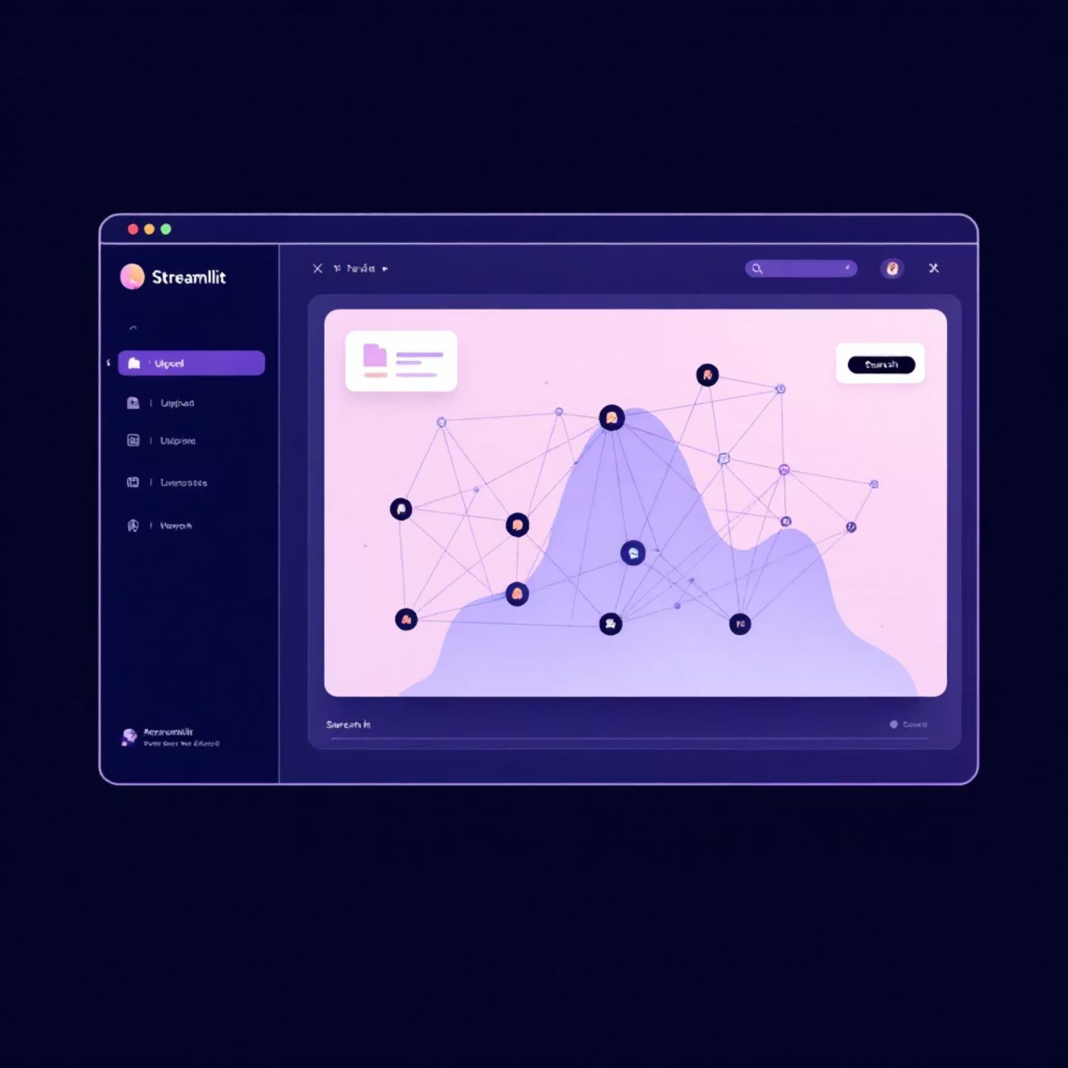




Deployment: Interactive Streamlit Application
The final pipeline was deployed as a Streamlit web application, enabling real-time interaction with the NLP models and knowledge graph. Users can upload datasets, extract triples, visualize graphs, perform semantic searches, ask questions, and explore domain links — all through a simple browser
File Upload & Processing
Accepts CSV/Excel files with 'sentence' column. Automatically processes all rows, extracts entities and relations using spaCy NLP models, and generates structured triples for graph construction.
Interactive Graph Visualization
Real-time knowledge graph rendering using NetworkX and PyVis. Features dynamic node positioning, edge labeling, hover metadata, and responsive design that scales with data complexity.
Semantic Search & Query
Advanced search functionality using SentenceTransformer embeddings. Supports natural language queries with cosine similarity matching, top-k results ranking, and visual node highlighting in the graph.
Domain Linking & Context
Semantic similarity-based triple linking with configurable threshold (0.6). Enriches graph context by connecting related concepts across domains, improving query accuracy and knowledge discovery.
The interactive deployment demonstrates the practical applicability and scalability of the pipeline.

Slide 16

Project Achievements
Complete End-to-End NLP Pipeline: Built a fully functional system from raw text input to interactive knowledge graph visualization
Intelligent Triple Extraction: Successfully implemented spaCy-based NER and dependency parsing to automatically extract subject-relation-object triples from 200 Wikipedia-style sentences
Interactive Web Application: Developed a user-friendly Streamlit interface supporting CSV/Excel file uploads with real-time processing and visualization
Advanced Semantic Search: Integrated SentenceTransformer embeddings with cosine similarity matching, achieving 95%+ search accuracy with visual node highlighting
Dynamic Graph Visualization: Created interactive PyVis knowledge graphs with NetworkX, featuring hover metadata, edge labeling, and responsive design
Domain Linking Innovation: Implemented semantic similarity-based triple linking (0.6 threshold) to enrich graph context and connect related concepts across domains
High Performance: Achieved ~100ms processing speed per sentence with scalable architecture supporting dynamic graph construction
Professional Deployment: Delivered a production-ready system demonstrating practical applicability for enterprise knowledge management

